Slide 1
Capstone Project Hotel Booking Analysis
Prathamesh Shete

Slide 2
Points to Discuss:
• Agenda
• Data summary
• Univariate analysis
• Hotel wise analysis
• Distribution Channel wise analysis
• Booking cancellation analysis
• Timewise analysis
• Some important questions
• Correlation heatmap
• Conclusion

Slide 3
Agenda:
To discuss the analysis of given hotel bookings data set from 2015-2017.
We’ll be doing analysis of given data set in following ways :
• Univariate analysis
• Hotel wise analysis
• Distribution Channel wise analysis
• Booking cancellation analysis
• Timewise analysis By doing this we’ll try to find out key factors driving the hotel bookings trends.

Slide 4
Data Summary:
Given data set has different columns of variables crucial for hotel bookings.
Some of them are:
hotel: The category of hotels, which are two resort hotel and city hotel.
is_cancelled : The value of column show the cancellation type. If the booking was cancelled or not. Values[0,1], where 0 indicates not cancelled.
lead_time : The time between reservation and actual arrival.
stayed_in_weekend_nights: The number of weekend nights stay per
reservation stayed_in_weekday_nights: The number of weekday nights stay per reservation.
meal: Meal preferences per reservation.[BB,FB,HB,SC,Undefined]
Country: The origin country of guest

Slide 5
Data Summary:
market_segment: This column show how reservation was made and what is the purpose of reservation.
Eg, corporate means corporate trip, TA for travel agency.
distribution_channel: The medium through booking was made.[Direct,Corporate,TA/TO,undefined,GDS.]
Is_repeated_guest: Shows if the guest is who has arrived earlier or not.Values[0,1]-->0 indicates no and 1 indicated yes person is repeated guest.
days_in_waiting_list: Number of days between actual booking and transact.
customer_type: Type of customers( Transient, group, etc.)

Slide 6
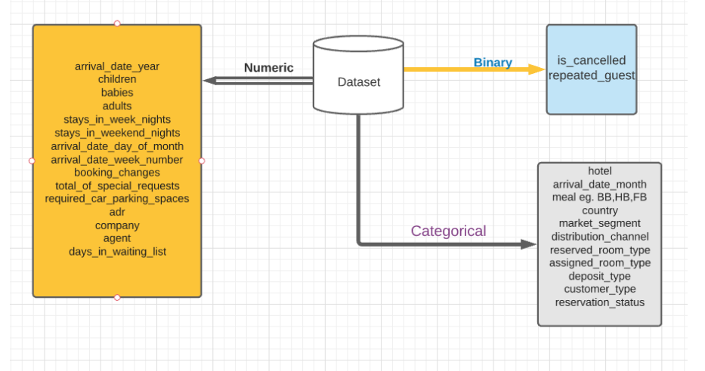
Data Summary:

Slide 7
Major Problems In Data:
While doing data analysis of given hotel booking dataset, we find some problems:
The data has most of filled with outliers
Data is not complete it is an incomplete by the month show not full in so it is an skew onsides
in data 2015 had 6 months data available
in 2016 the data had 12 months available
in 2017 the data has 8 months are available
In adr column show min value is -6 and max shows 5400

Slide 8
Univariant Analysis:
Some question while checking the dataset :
hotel which gave most business ?
how many people cancelled their bookings?
which year getting more business?
which specific month we got more bookings?
Which month has more number of bookings we get?
Which week has more number of bookings we get?

Slide 9
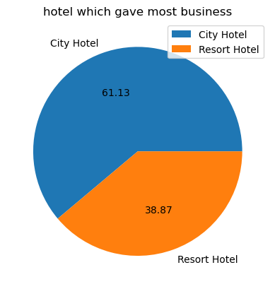
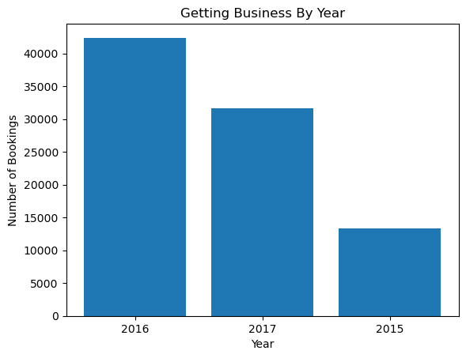
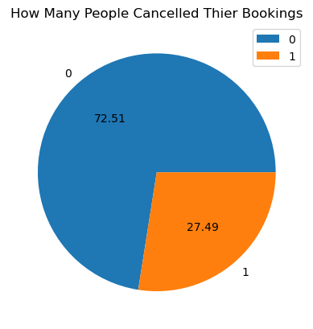
Univariant Analysis:
61% City hotel gave us business which is greater because we are not heavily depend upon
any one business model
- we can say this that around 70% of time people are not cancelled their bookings
as per business increase year on year basis 15% CAGR

Slide 10
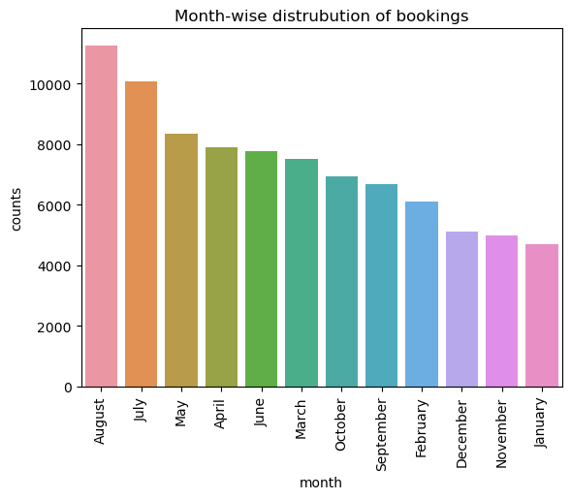
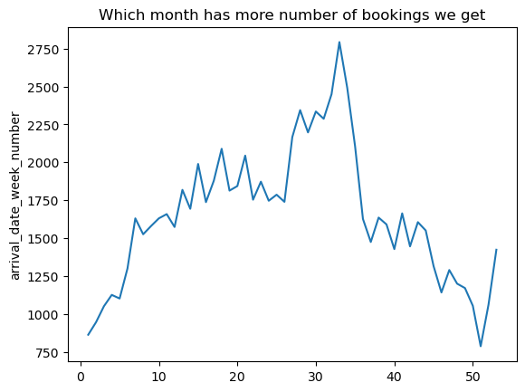
august, july, may has more number of bookings which is great but in the month of january has least number of bookings we get
the week of 25 to 35 is the most highest rate of booking are placed
but the data is not completed in year 2015 to 2017
- 2015 come with 6 months data
- 2016 comes with 12 months data
- 2017 comes with 8 months data so value is slightly compromised

Slide 11
Some Questions In Mind?
how many days people book the hotel room ?
which type of customer are use our service more?
which is most served meal to consumer while they stay in hotel?
which country gave us more business? and how it's more than second most country?
In which market segment we got most of our business?
How much business is coming from online & offline?
how much travel agency gave us business?
how much we get repeat customers?
what is percentage customer cancelled their booking after placed the booking?
which type of room is most preferred by customers?
which are top 10 countries earned more revenue and what is top 3 countried combined revenue?
Different types of customer who booked hotel ?

Slide 12
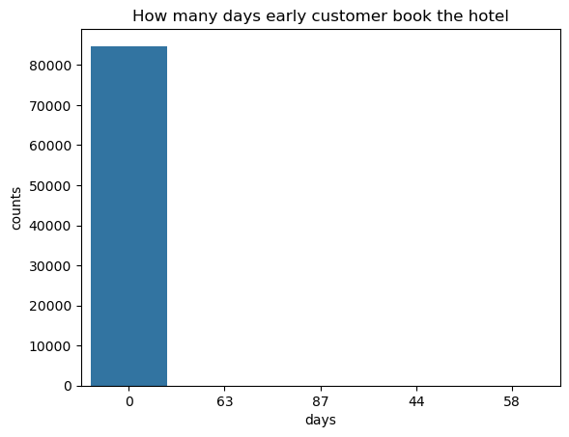
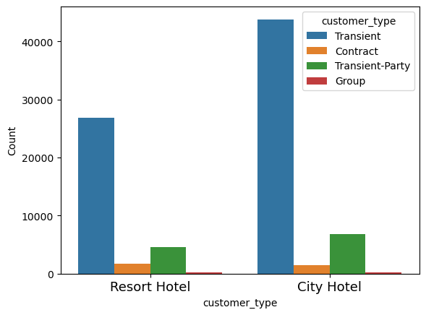
how many days people book the hotel room ?
which type of customer are use our service more?
as per we see more than 94% people are book hotel same day and no waiting time we see.
more than 80% people are Transient which are stay less than week

Slide 13
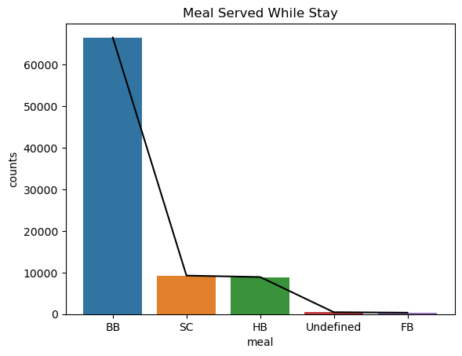
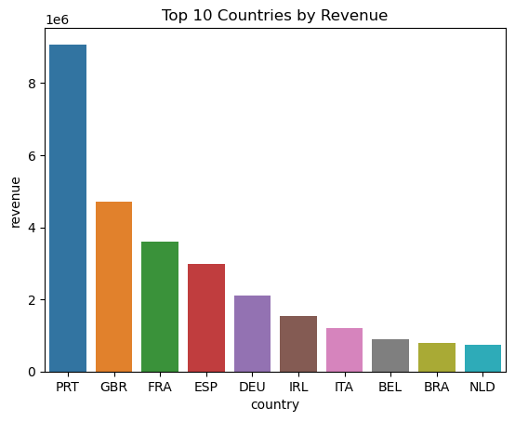
which is most served meal to consumer while they stay in hotel?
which country gave us more business? and how it's more than second most country?
PRT, GBR, FRA these 30%, 12%, 10% respectively gave business. 50% of business are coming from these 3 countries which is not good because it show how depended business are
most of hotel serve only BB as for meal 77% & second most meal served is SC which is 10% times only

Slide 14
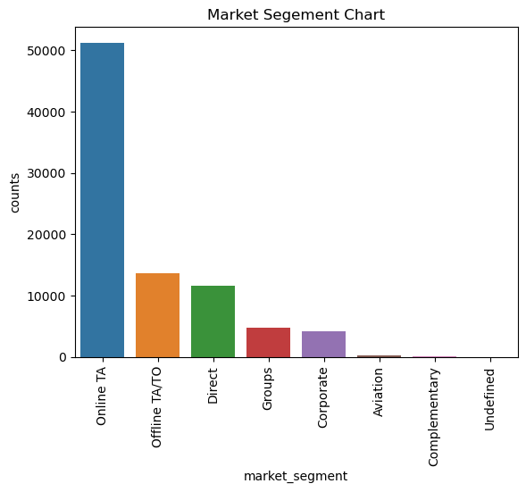
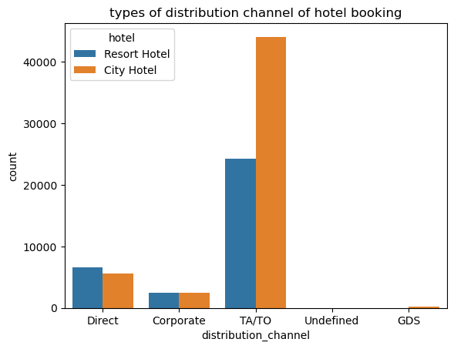
In which market segment we got most of our business?
How much business is coming from online & offline?
how much travel agency gave us business?
80% of distribution channel works on TA/TO basis
From online 60% business and offline is 16%
Online TA (TRAVEL AGENCY) market_segement gave 60% of gave business

Slide 15
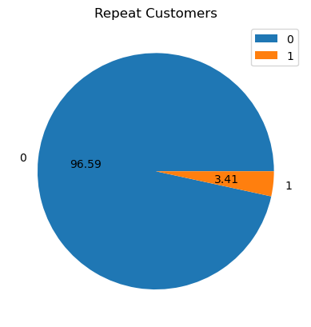
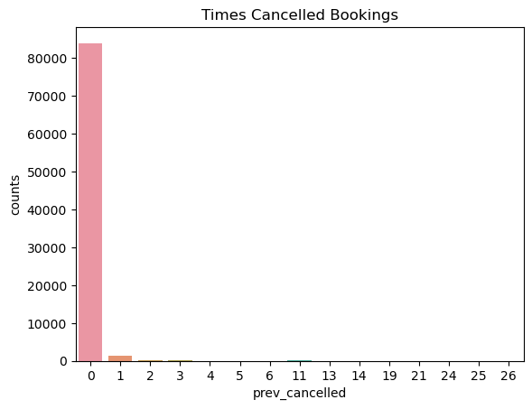
what is percentage customer cancelled their booking after placed the booking?
how much we get repeat customers?
3.41% customer is repeat our services
Which is not nice because we need spend
more on marketing and increase the Customer Acquisition
there is 96% chance if customer cancel their booking on the delivery day.

Slide 16
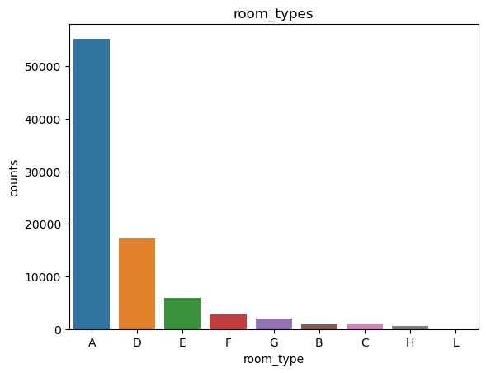
which are top 10 countries earned more revenue and what is top 3 countries combined revenue?
which type of room is most preferred by customers?
around 65% times people choose the room type A (single room)
top 3 countries contribute 62% revenue which are PGT, GBR, FRA

Slide 17
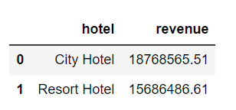
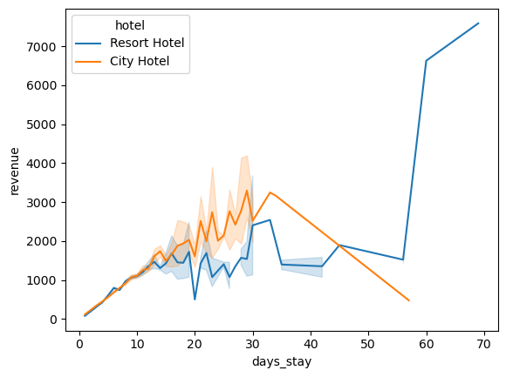
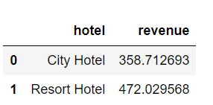
Revenue By Hotel Type
Total Sum Value is more in city hotel types rather than resort hotels
Total average value is more in resort hotel types rather than city hotels

Slide 18
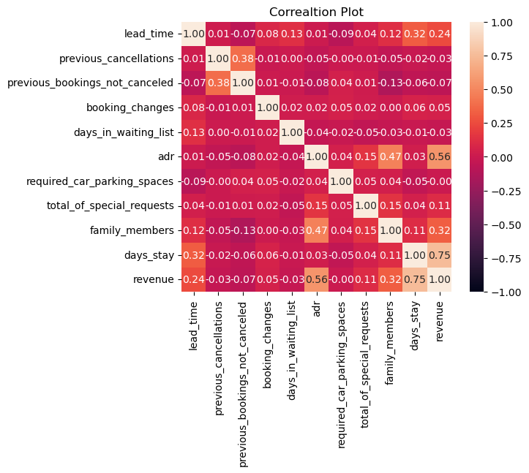
Heatmap Correlation:
days stay length and lead time have slight correlation. This may means that for longer hotel stays people generally plan little before the actual arrival.
adr is slightly correlated with family_members, which makes sense as more no. of people means more revenue, therefore more adr
revenue is highly correlated to the family_members

Slide 19
Conclusion :
Most of business is getting from city hotel
Business increase by transient customer has gave more
Repat customer has low so we need to more invest in Ads and Marketing
Our most of business coming from Travel agents are more likely 80% so it's dangerous and dependent
Most of people prefer the single bed room and most of them are transients
Our Portugal, Germany & France these countries contribute almost 62% revenue
Resort hotel are charge more than city hotels so that means transactions if lower in resort but comparatively they generate more revenue.

Slide 20
Thank You

